Slide 1

Hack Night Bern dapr
ti&m
Moritz Baumotte, Martin Kräuchi
Bern, 05. März 2025

Slide 2
Agenda
Intro
First demo
doing the Installation and go thourg university example
have a look at a funny example
possible challenges to solve
pizza
working on your challange with your peer
let’s enjoy this evening!

Slide 3
Resources
https://github.com/Bern-Hack-Night source, powerpoint
https://dapr.io/ main page
https://dapr.io/learn/ online tools
https://docs.dapr.io/getting-started/ installation
https://www.diagrid.io/dapr-university here we start
https://github.com/dapr
https://github.com/dapr/quickstarts.git

Slide 4
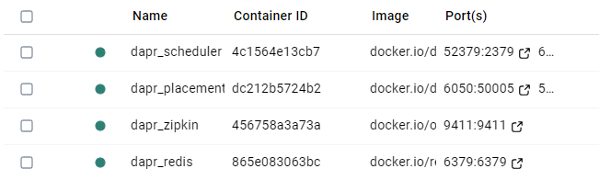
Tooling
install Docker Desktop
install Visual Studio 2022 / IntelliJ / Visual Studio Code + Plug Ins
For Dapr Installation follow https://docs.dapr.io/getting-started/install-dapr-cli/ Hint: start docker desktop before
for Windows:
powershell -Command "iwr -useb https://raw.githubusercontent.com/dapr/cli/master/install/install.ps1 | iex"
dapr –h
dapr init

Slide 5



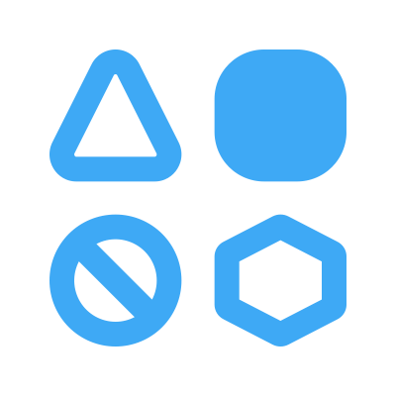
State of enterprise developers
Must develop resilient, scalable, distributed apps that interact with services.
Want to focus on writing code, not learning infrastructure.
Trending toward serverless platforms with simple code to cloud pipelines.
Use multiple languages and frameworks during development.

Slide 6


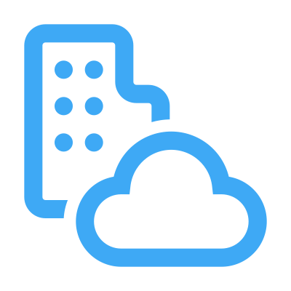
What is holding back distributed app development?
Limited tools and runtimes to build distributed applications.
Runtimes have limited language support and tightly controlled feature sets.
Runtimes only target specific infrastructure platforms with limited portability.

Slide 7




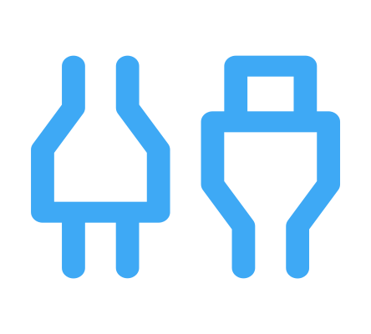

Dapr Goals
Provide an integrated set of APIs
Any language or framework
Includes best practices & standards
Platform agnostic
Extensible and pluggable
Community driven, vendor neutral

Slide 8
First, Dapr will reduce the complexity of the codebase and simplify it [2]. Things like message buses, retry policies, and secure communication between services can be handled by Dapr and therefore don't have to be learned [2] (but to be honest, they should be known anyway). Dapr abstracts the whole thing so that only the APIs have to be learned. [2].
https://medium.com/codex/whats-dapr-and-how-can-it-help-to-develop-better-microservices-692775f41e2a

Slide 9





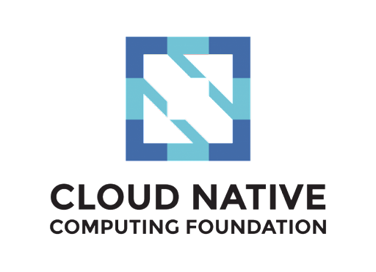






Dapr community
12/157
120
700k+
300k
Largest CNCF project
Community components
Docker Hub pulls/month
Unique doc views/month
📖
29k
3k
7k
GitHub stars
Contributors
Discord members
⭐

Slide 10
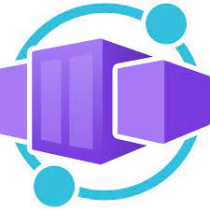

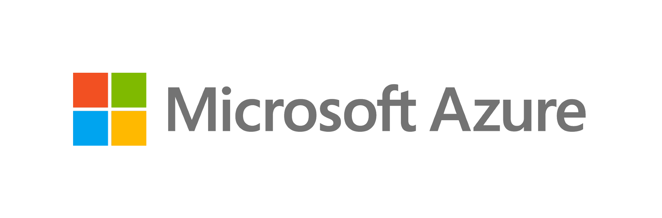



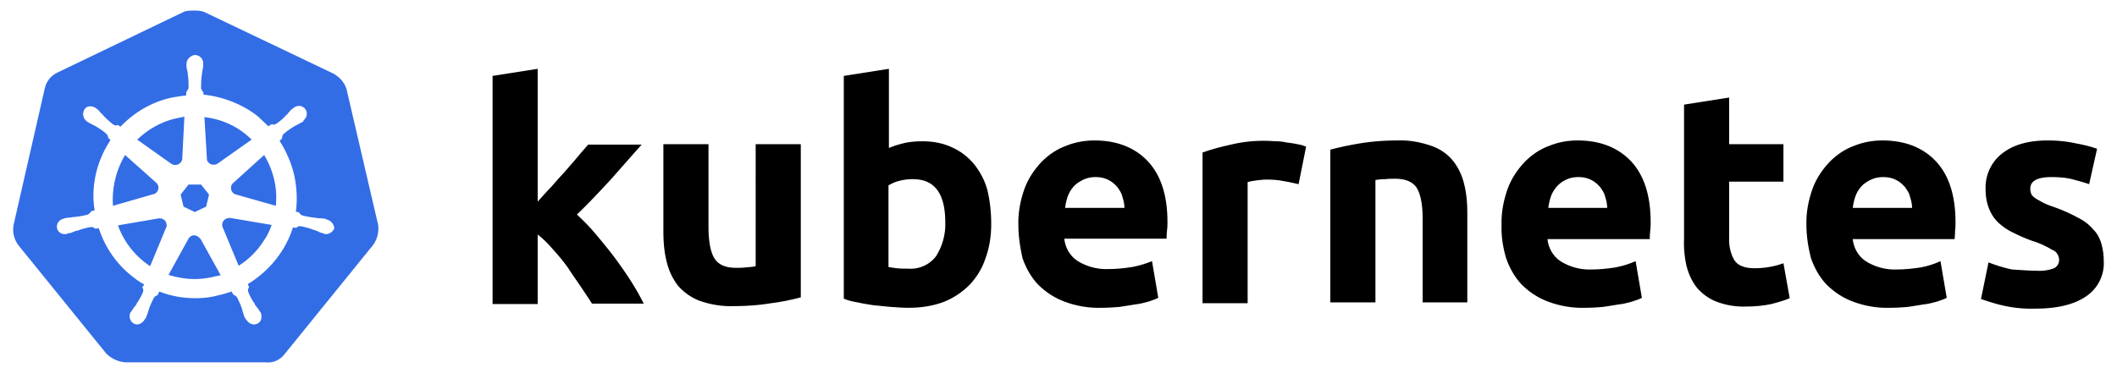
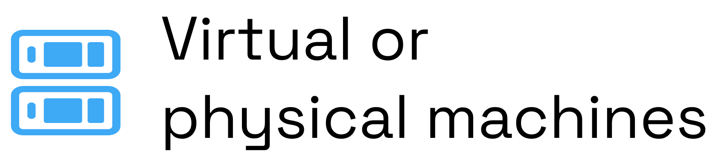
Use Dapr anywhere
Azure Container Apps

Slide 11
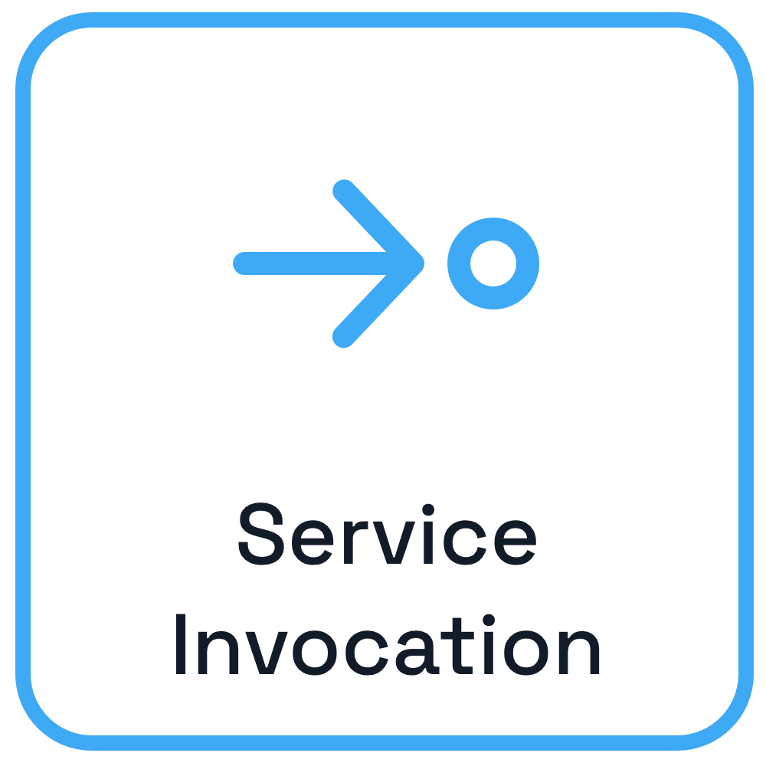

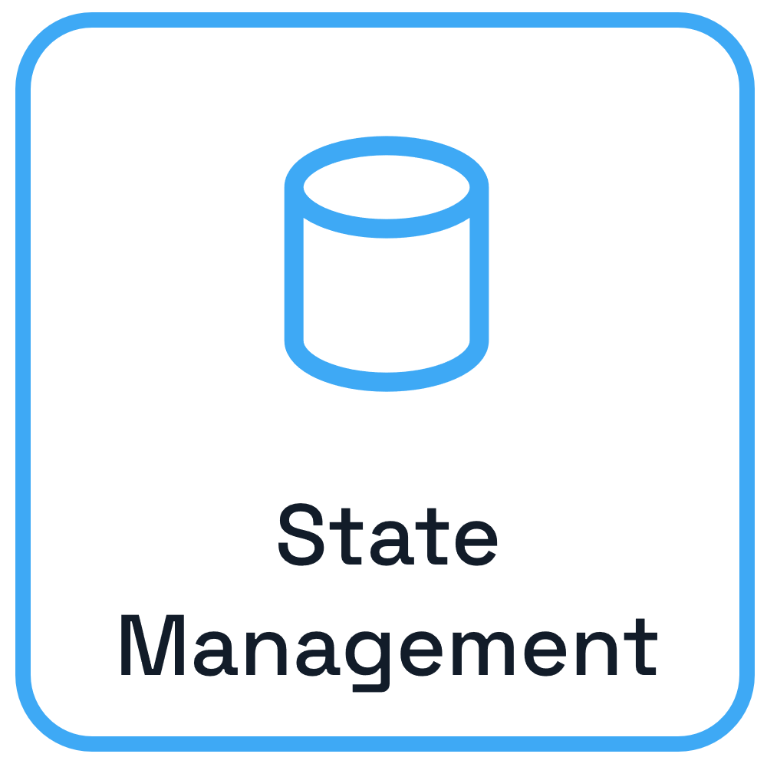
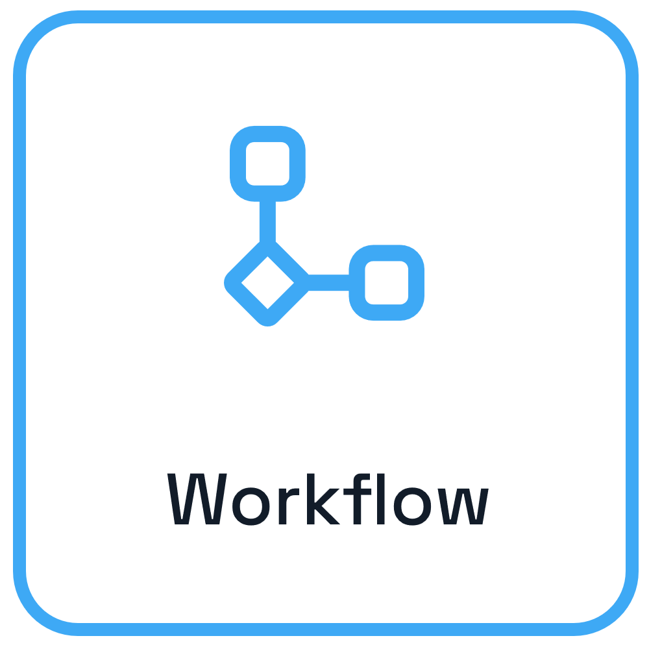


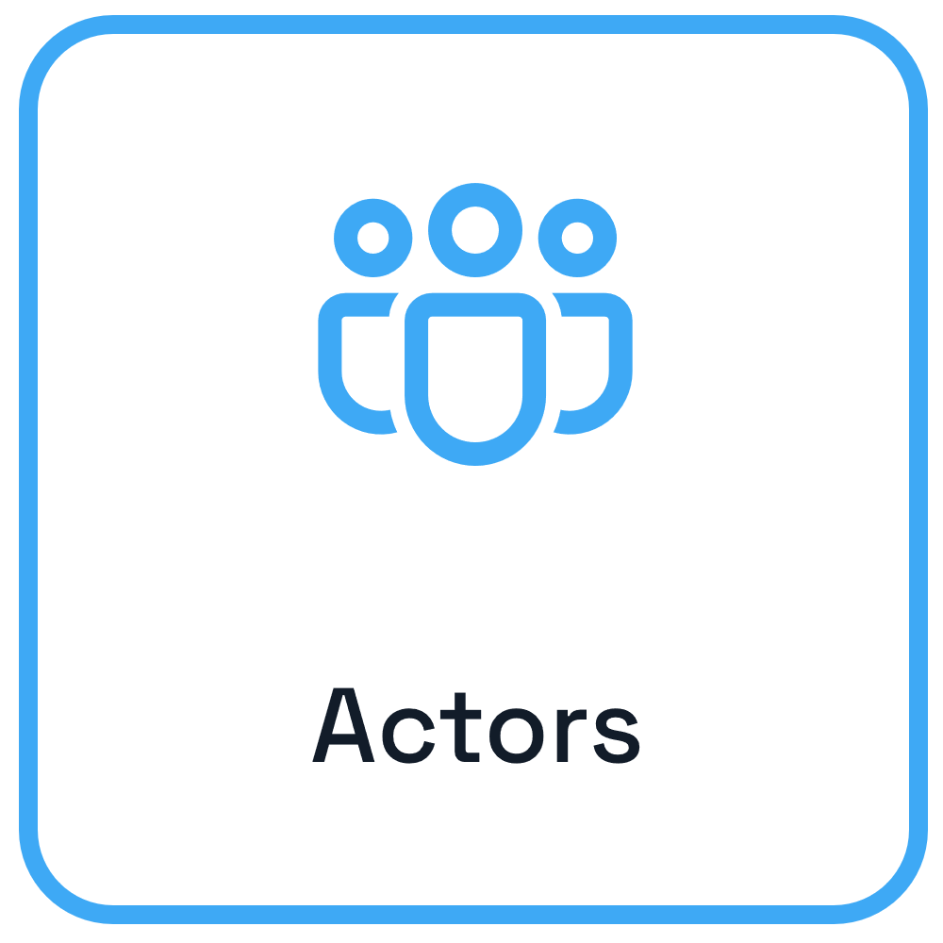
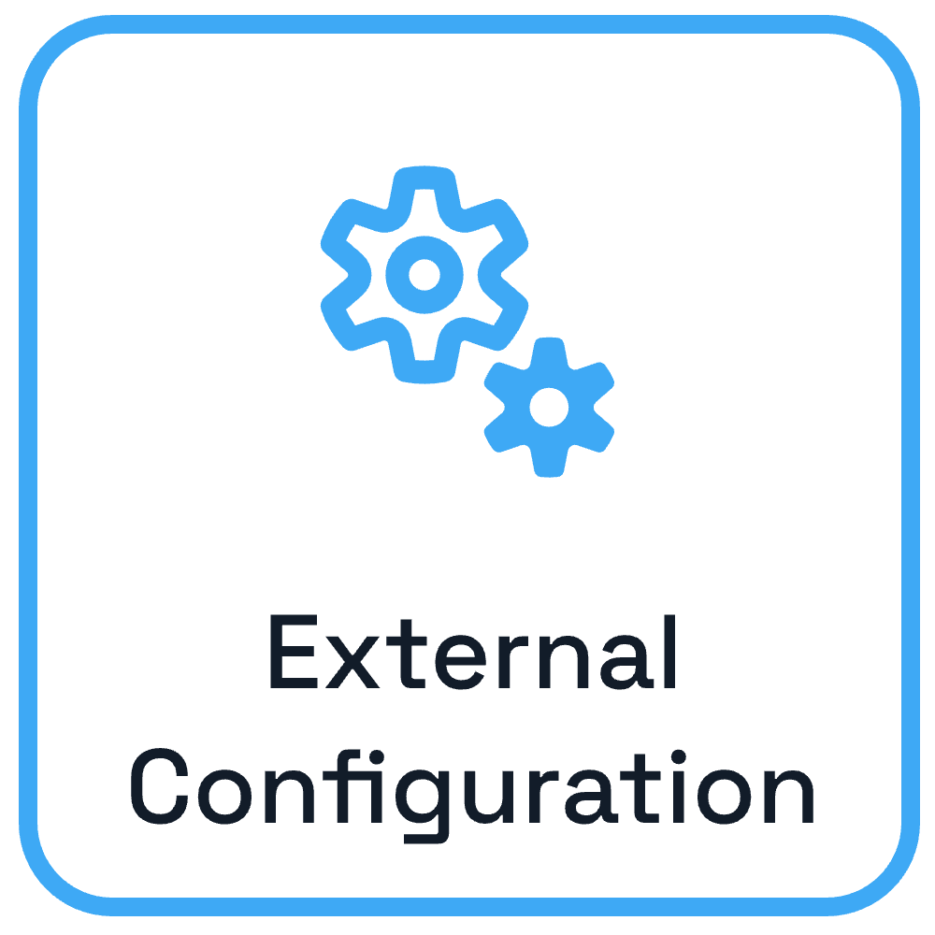
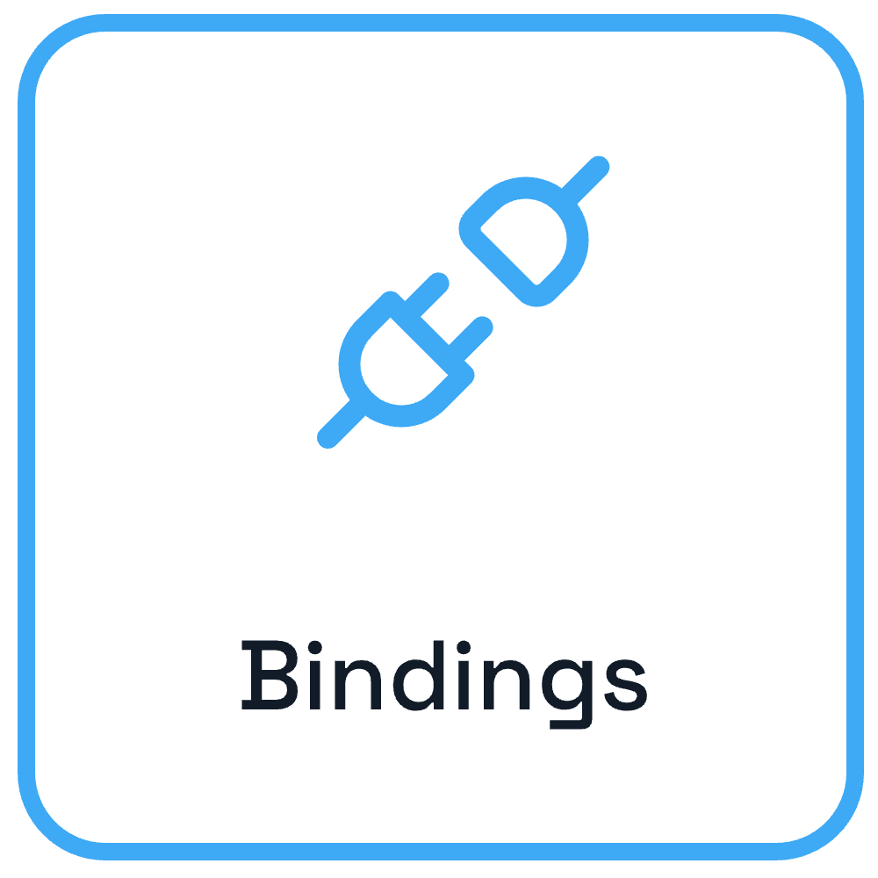


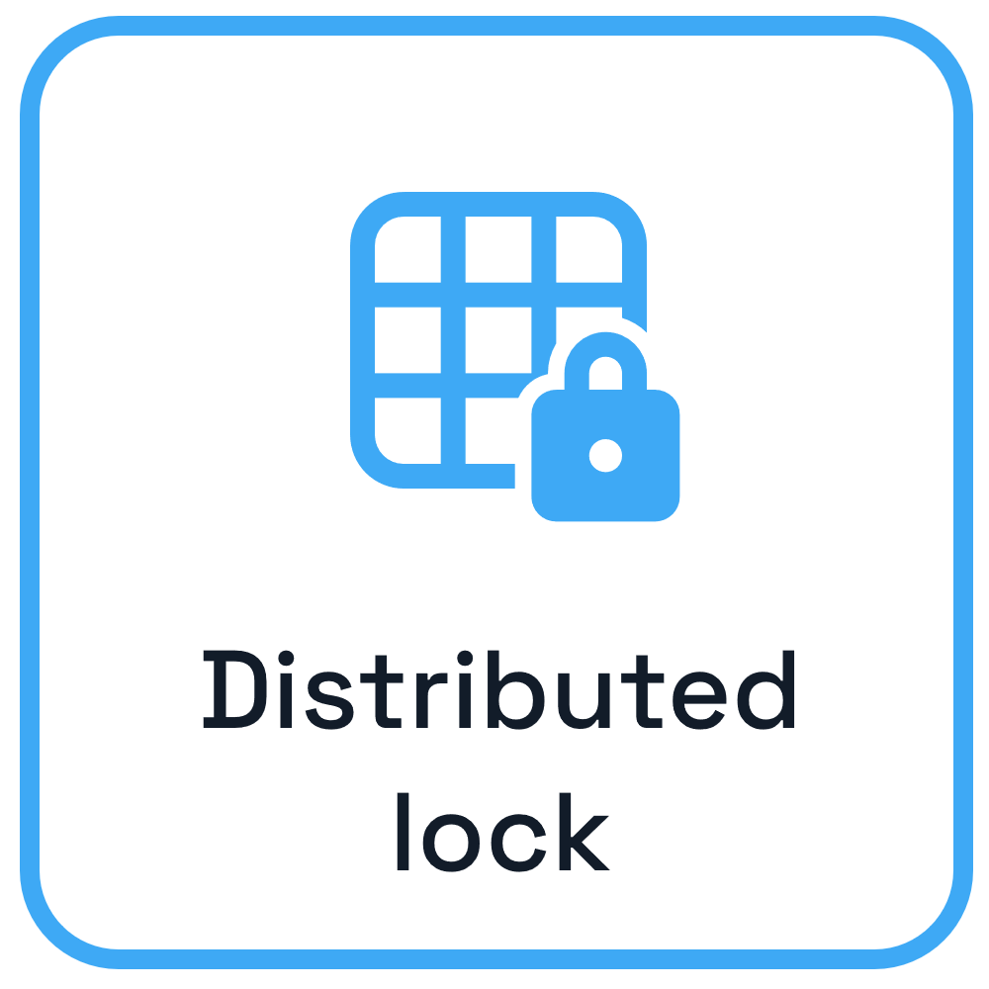

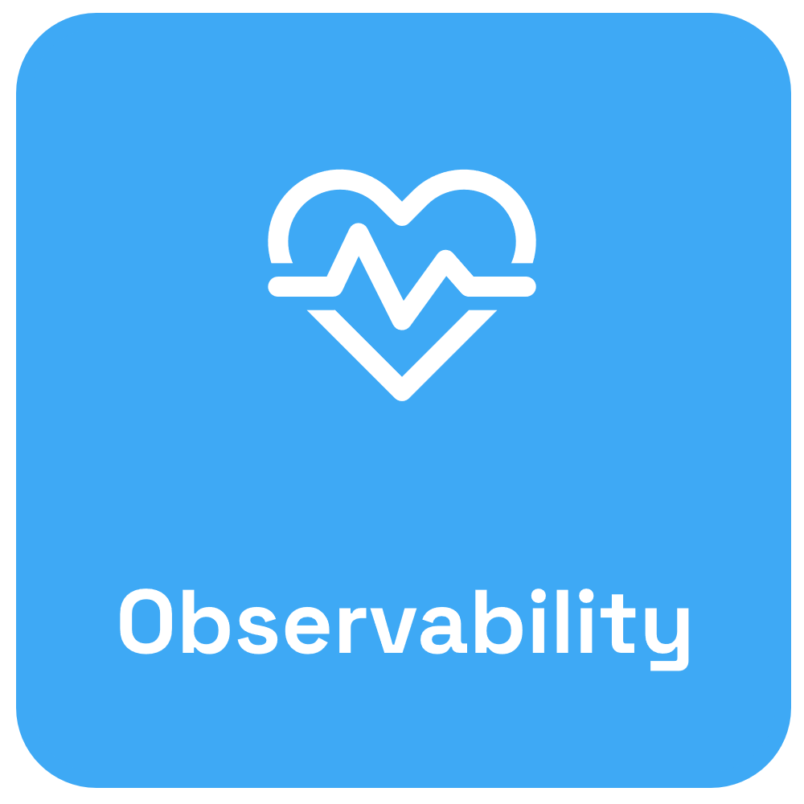

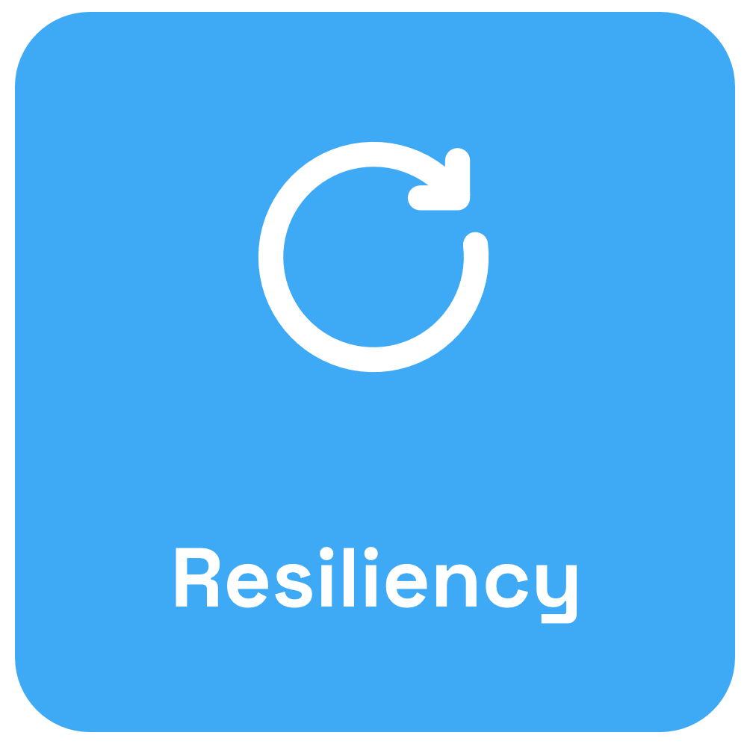
Dapr APIs & Cross cutting concerns
App B
App A
App C

Slide 12
Sidecar pattern and the Dapr API
Dapr API
My App
App
HTTP/gRPC
Application code
Dapr sidecar
POST http://localhost:3500/v1.0/invoke/cart/method/order
GET http://localhost:3500/v1.0/state/inventory/item50
POST http://localhost:3500/v1.0/publish/mybroker/order-messages
GET http://localhost:3500/v1.0/secrets/vault/dbaccess
POST http://localhost:3500/v1.0-beta1/workflows/dapr/businessprocess/start

Slide 13



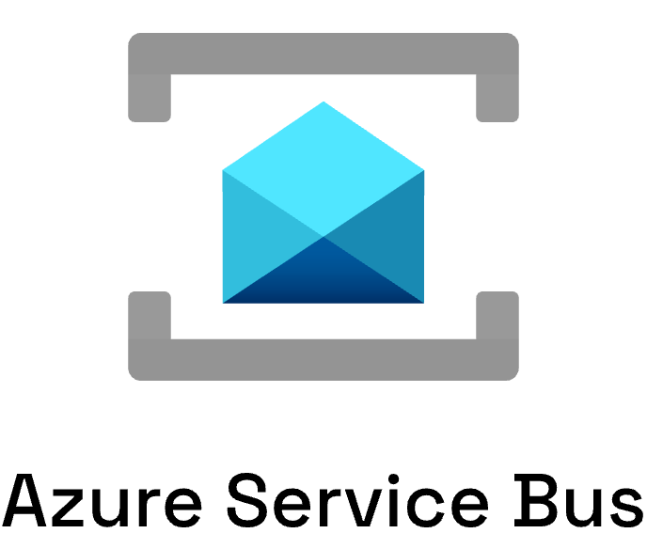

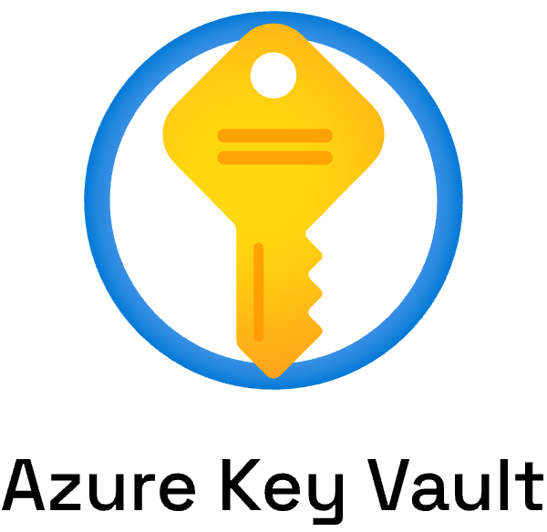
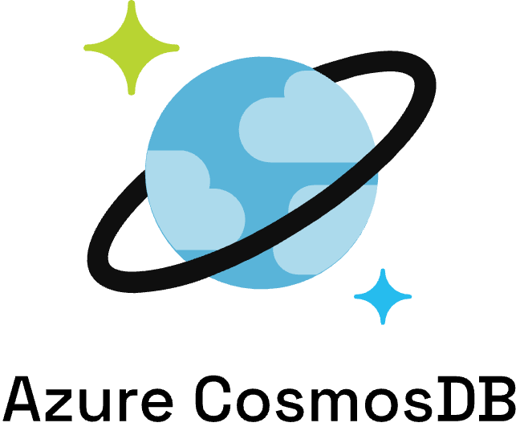

Swappable component model

Slide 14
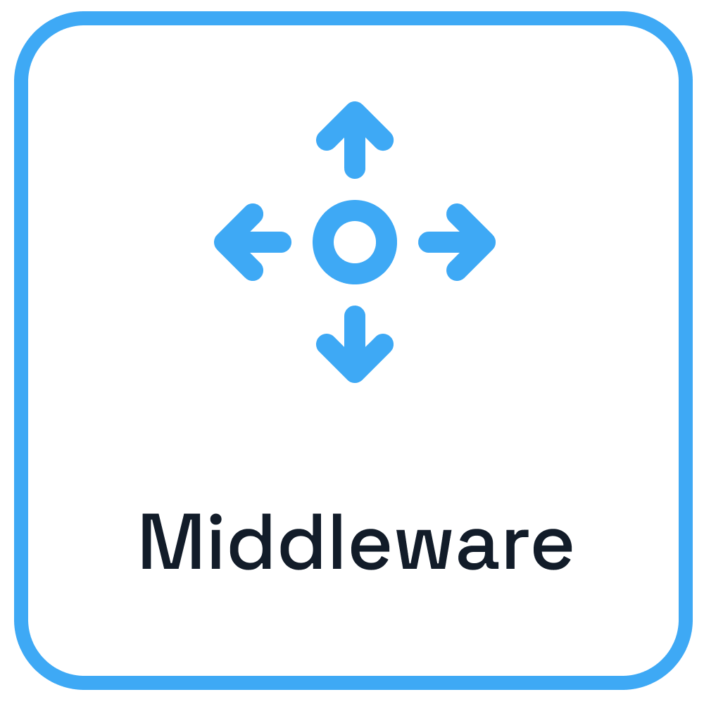
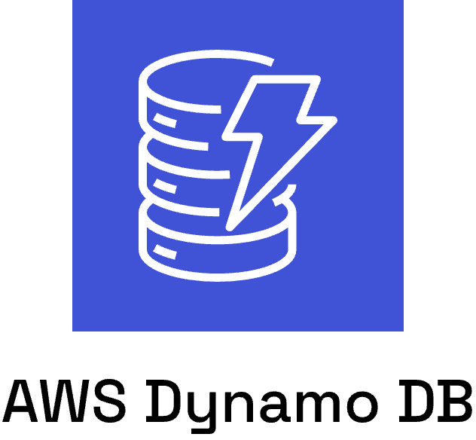
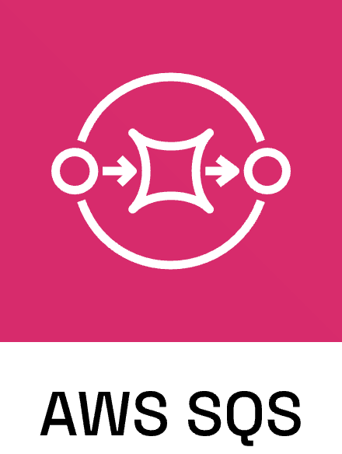
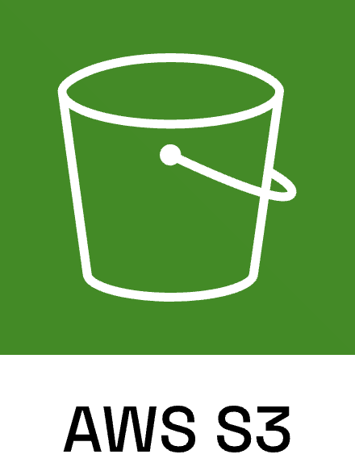

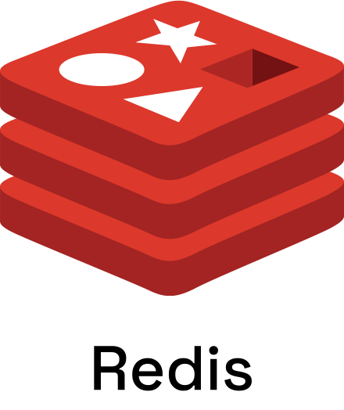

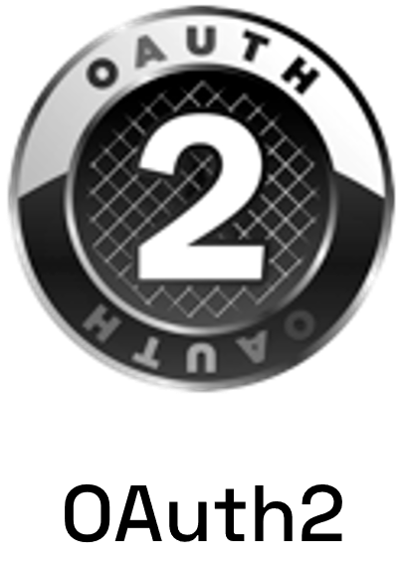
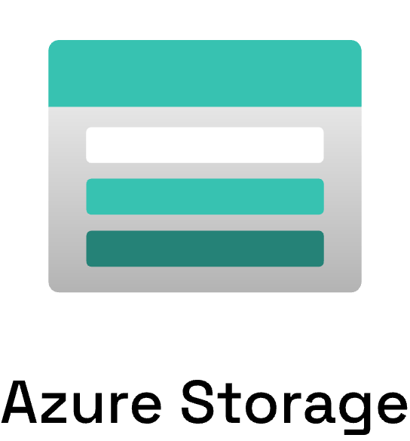
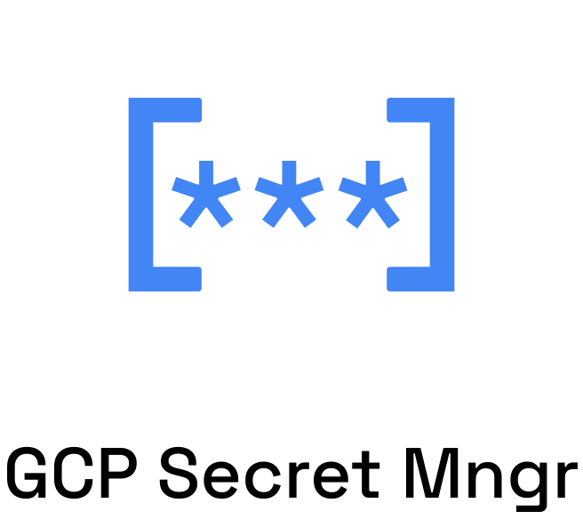
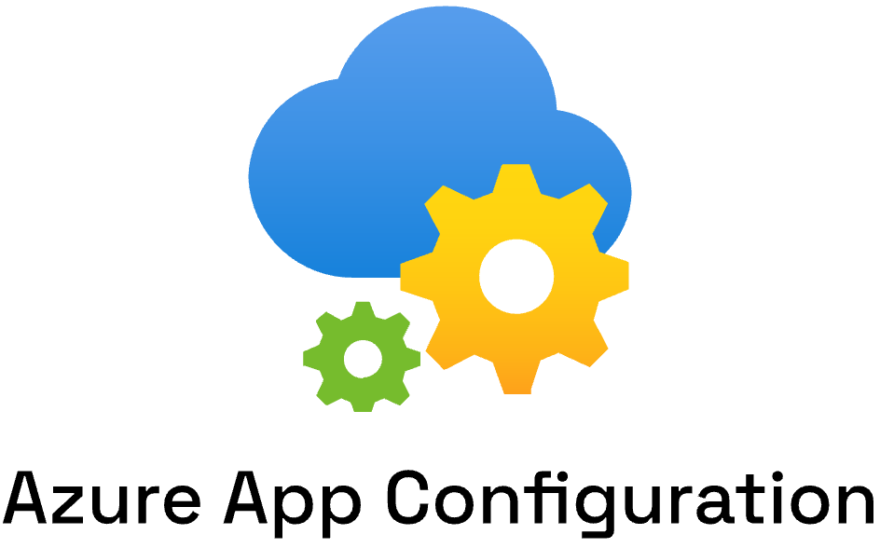
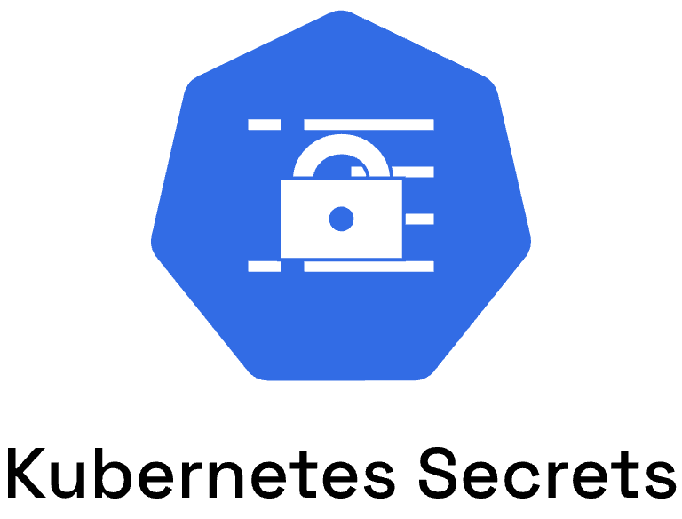
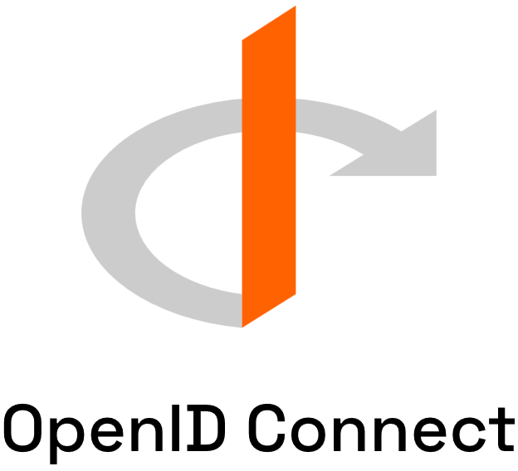
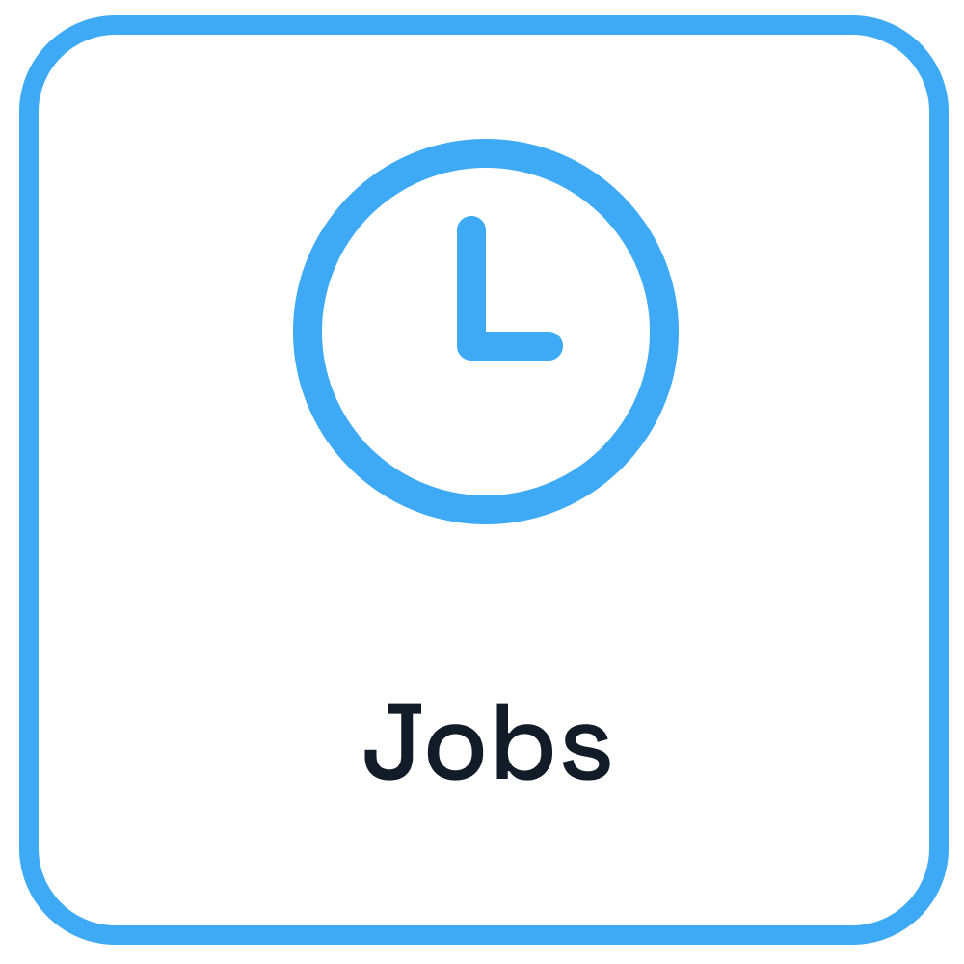

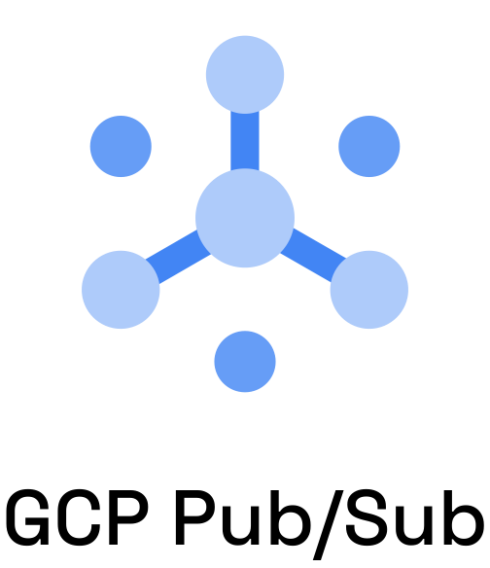
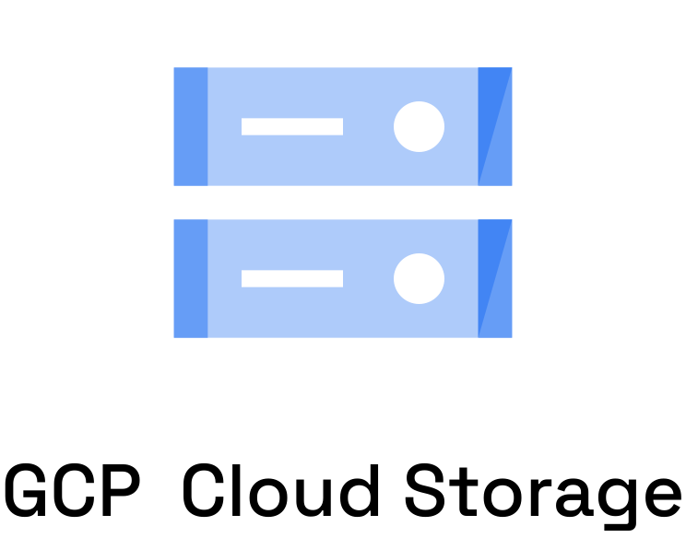

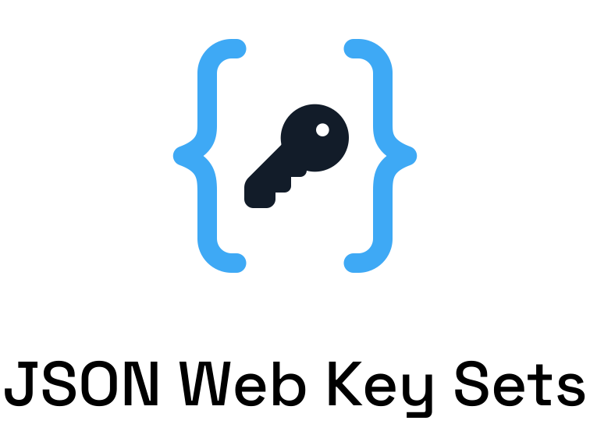





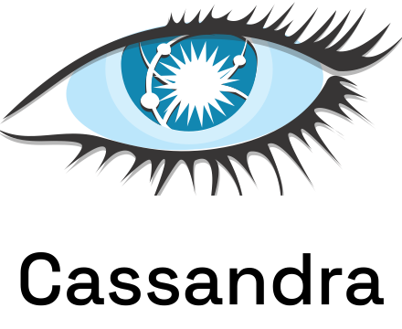




Dapr components
App

Slide 15
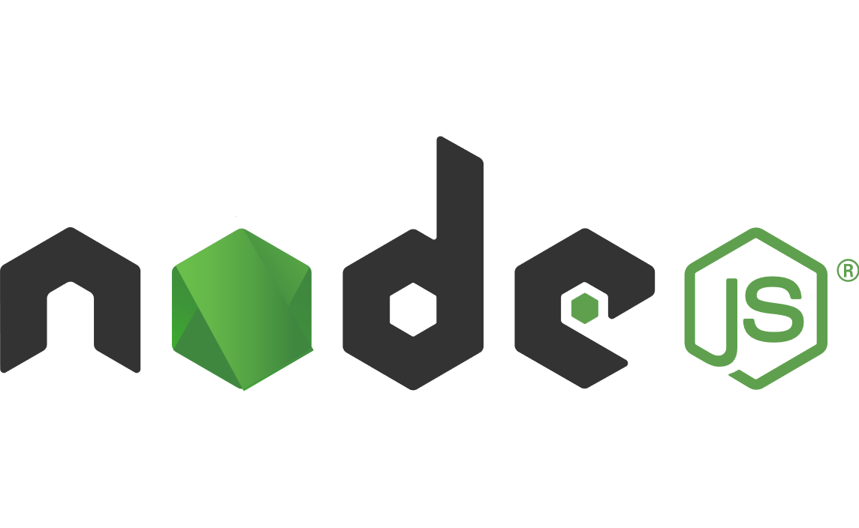


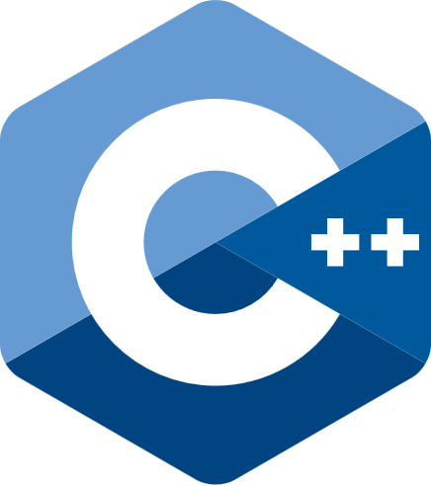

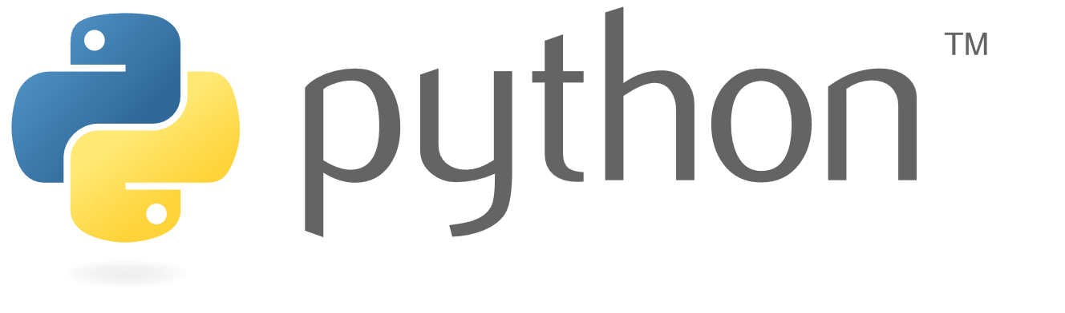



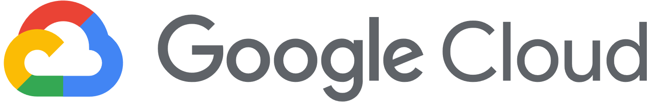
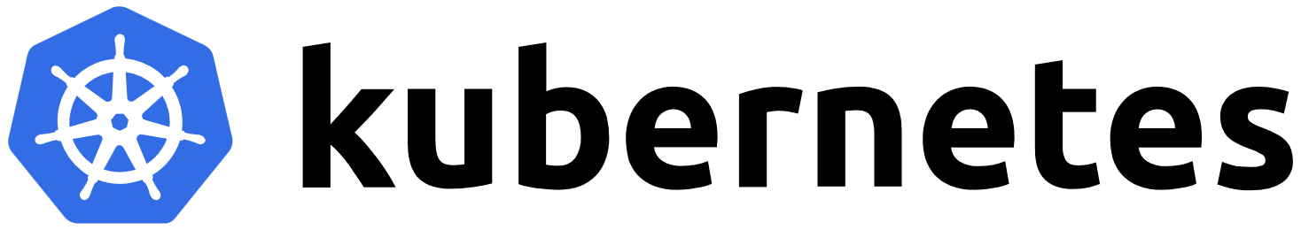

Dapr from development to hosting
Use any language or runtime
App
HTTP/gRPC
Host on & integrate with any cloud or edge infrastructure
Databases
Message Brokers
Services

Slide 16
Challenges – some ideas to start with a slice of pizza in your hand
Create a simple sign-off process
sends a request to B) for signing the contract
says yes or no and send it back to A)
Create a simple chat
sends a message to B)
receives the message and can answer sending back a message to A)
Make Music Service recoverable
- MusicEmitter should use the state store to persist the current progress in the music. When it restarts it should continue playing the music.
You can start from the scratch or adapt the service invocation or maybe better the pubsub example under quickstarts; check out https://github.com/dapr/quickstarts.git

Slide 17
Actor Challenge -
In der vorliegenden Version gibt es einen Aspekt der sehr unnatürlich ist: Der Alarm wird von der Console ausgelöst. await proxySmartDevice1.DetectSmokeAsync(); In der Realität wäre es der SmokeDetector, der den Alarm detektiert.
Baue das Programm so um, dass der SmokeDetector nach Zufallsprinzip einen Alarm auslöst.
In the original version there is one aspect that is very unnaturl: The alam is triggered by the console app
await proxySmartDevice1.DetectSmokeAsync();
In reality it would be the SmokeDetector that detects the alarm
Rebuild the program so that the SmokeDetector triggers an alarm at random.

Slide 18
Service Invocation Demo
https://docs.dapr.io/getting-started/quickstarts/serviceinvocation-quickstart/

Slide 19



Service Invocation
Name resolution component for service discovery
Observability backend
DNS
Invoke method
Customer
Checkout
mTLS encryption
POST http://localhost:3500/v1.0/invoke/checkout/method/order
POST http://localhost:5100/order
Notes:
Name Resolution component for service discovery: mDNS, Kubernetes DNS, Hashicorp Consul

Slide 20
Service Invocation Demo
https://docs.dapr.io/getting-started/quickstarts/serviceinvocation-quickstart/

Slide 21
Publish / Subscribe API
https://docs.dapr.io/developing-applications/building-blocks/pubsub/

Slide 22

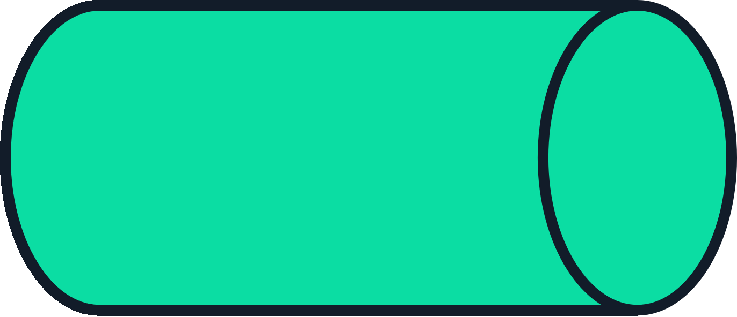
Publish / Subscribe
Observability backend
Cloudevents
Publisher
Message
broker
Subscriber
POST http://localhost:3500/v1.0/publish/mybroker/order-messages
POST http://localhost:5100/orders

Slide 23
Publish / Subscribe Demo
https://docs.dapr.io/getting-started/quickstarts/pubsub-quickstart/

Slide 24
Actors API
https://docs.dapr.io/developing-applications/building-blocks/actors/

Slide 25
Actors
- Uses the Virtual Actor pattern
- State is persisted in a configurable state store
- Uses turn-based access in concurrent systems
- Built-in actor distribution and fail-over
- Schedule period work using timers & reminders
- Author actors in C#, Java, JavaScript, Python and Go
- Use the Actors API with any language
The Actors API allows to write concurrent applications using the actor model.

Slide 26
Virtual Actor Model
Actor lifetime is not tied to their in-memory representation. No need to explicitly create or destroy an actor.
Notes:
Name Resolution component for service discovery: mDNS, Kubernetes DNS, Hashicorp Consul

Slide 27


Actor placement
Pod 1
My App
POST /v1.0/actors/MyActor/A/method/update
App Instance 1
MyActor A
3
2
1
MyActor B
Pod 2
Actor Type | Dapr Instances
MyActor | Partition1 Partition2
OtherActor | Partition 2
1
Placement Service
App Instance 2
MyActor C
OtherActor A
Notes:
Name Resolution component for service discovery: mDNS, Kubernetes DNS, Hashicorp Consul

Slide 28
Actors API
Invoke the update method on MyActor “A”
Create actor reminder
POST /v1.0/actors/MyActor/A/method/update
POST /v1.0/actors/MyActor/A/reminders/process
Save MyActor “A” state
Create actor timer
POST /v1.0/actors/MyActor/A/state
POST /v1.0/actors/MyActor/A/timer/process
Get MyActor “A” state
GET /v1.0/actors/MyActor/A/state/key
Notes:
Name Resolution component for service discovery: mDNS, Kubernetes DNS, Hashicorp Consul

Slide 29
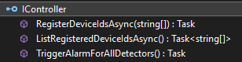
Actor Example from Quickstarts
docker / local program
WebApplication as DaprHost
ISmartDevice
Smoke-DetectorActor
A
console app SmartDevice. Client
Program.cs
App Instance 1
proxies => instances
ISmartDevice
Smoke-DetectorActor
B
register
register
create ISmartDevice SmokeDetectorActor A + B
create IController ControllerActor
IController
Placement Service
Controller-Actor
Notes:
Name Resolution component for service discovery: mDNS, Kubernetes DNS, Hashicorp Consul

Slide 30
Authoring Actors with .NET SDK
public interface ISmartDevice : IActor
{
Task<string> SetDataAsync(SmartDeviceData device);
Task<SmartDeviceData> GetDataAsync();
Task DetectSmokeAsync();
Task SoundAlarm();
Task ClearAlarm();
}
public class SmartDeviceData
{
public string Status { get; set; } = default!;
public string Location { get; set; } = default!; }
Notes:
Name Resolution component for service discovery: mDNS, Kubernetes DNS, Hashicorp Consul

Slide 31
Authoring Actors with .NET SDK
var deviceActorId1 = new ActorId("device1");
// Create a new instance of the data class that will be stored in the actor
var deviceData1 = new SmartDeviceData(){
Location = "First Floor",
Status = "Ready",
};
// Create the local proxy by using the same interface that the service implements.
// You need to provide the type and id so the actor can be located.
// If the actor matching this id does not exist, it will be created
var proxySmartDevice1 = ActorProxy.Create<ISmartDevice>(
deviceActorId1,
"SmokeDetectorActor");
// Now you can use the actor interface to call the actor's methods.
var setDataResponse1 = await proxySmartDevice1.SetDataAsync(deviceData1);
Notes:
Name Resolution component for service discovery: mDNS, Kubernetes DNS, Hashicorp Consul

Slide 32
Actor Ressources
https://adabeat.com/fps/single-process-microservice-architectures-using-dapr-actors-and-f-by-jonas-juselius/

Slide 33
Actors Demo
https://docs.dapr.io/getting-started/quickstarts/actors-quickstart/

